Slide 1
Overview of Archaea
Information from http://www.cook.rutgers.edu/~dbm/lec14grad.pdf and Campbell Biology 8th Edition, 2009.

Slide 2
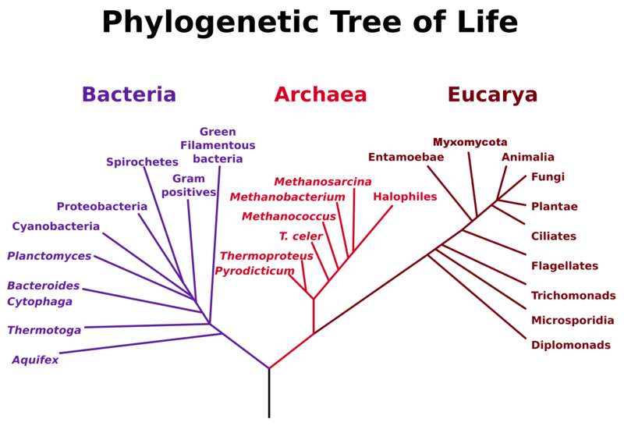
3 Domains of life…
Viruses???

Slide 3
General Characteristics
Diverse group of Prokaryotes (no membrane bound organelles)
Extremophiles
Chemoautotrophs (use inorganic chemicals as source of energy, examples: H₂S, NH₃, Fe²⁺) Carbon dioxide as C source
No nuclear envelope (makes sense…no nucleus)
Only domain with branched hydrocarbons in membrane
Have introns (intervening sequences) in some genes
Growth not inhibited by antibiotics
Histones (proteins that DNA is wrapped around)
Circular DNA chromosome
Some can grow in temperatures above 100°C

Slide 4
Where can archaebacteria be found? At the edges
Limits for microbial life
• Temperature: 0 to 113°C
• Salinity: up to 5.5 (32%) M NaCl
• pH 0 to 11
• Pressure: > 500 atm (up to 1,200 atm)

Slide 5
DEFINITION OF EXTREMOPHILIC ARCHAEA
Halophiles From the Greek halos- (salt), and philos (loving). Includes organisms that grow optimally at high salt concentrations
Psychrophiles From the Greek psychros- (cold), and philos (loving). Includes organisms that grow optimally at temperatures between 0 and 20°C
Thermophiles From the Greek therme- (heat), and philos (loving). Includes organisms that grow optimally at temperatures between 50 and 80°C
Hyperthermophiles From the Greek hyper- (over), therme- (heat), and philos (loving). Includes organisms that grow optimally at temperatures above 80°C
Barophiles or Piezophiles From the Greek baros- (weight), or piezein- (to press) and philos (loving). Includes organisms that grow optimally at pressures > 1 atmosphere
Methanogens Strictly anaerobic Archaea that produce methane
Thaumarchaeota: “wonder” still little known

Slide 6
Archaea Phyla
Phyla (Separated from other phyla by rRNA sequences)
Crenarchaeota
Euryarchaeota
Korarchaeota
Nanoarchaeota
Thaumarchaeota

Slide 7
Crenarchaeota
thermophilic and psychrophilic organisms organisms
Most abundant marine archaea
some have the ability to grow at up to 113 °C
All different shapes
Archaea Sulfolobus found in sulfur hot springs,

Slide 8
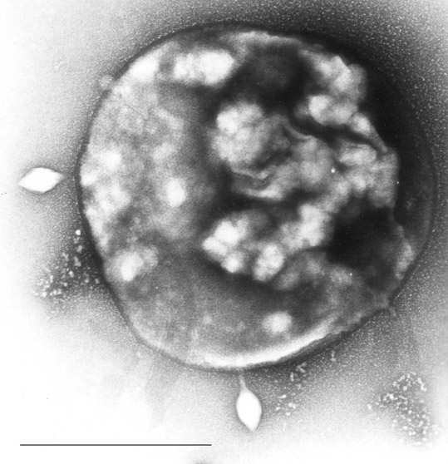
Archaea Sulfolobus infected with specific virus STSV-1.
http://en.wikipedia.org/wiki/File:RT8-4.jpg

Slide 9
Euryarchaeota
Methanogens: produce methane gas in animal guts…
Halogens: live in very salty environments
Some thermophiles (some aerobic, some anaerobic)

Slide 10
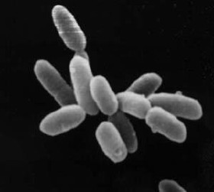
Halobacterium sp. strain NRC-1, each cell about 5 µm in length.
http://en.wikipedia.org/wiki/File:Halobacteria.jpg

Slide 11
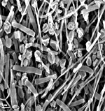
Korarchaeota
found only in high temperature hydrothermal environments
evolutionarily separated (diverged early)from Euryarchaeota and Crena
Candidatus Korarchaeum cryptofilum"
http://en.wikipedia.org/wiki/Korarchaeota

Slide 12
Nanoarchaeota
“old dwarf” extremely tiny
One known species Nanoarchaeum equitans.
Found 2002 in a hydrothermal vent
Parasitic
Smallest genome
70-98ºC, a pH around 6.0, and salt concentrations of about 2% NaCl. They grow on Ignicoccus cells in what is either a symbiotic or parasitic relationship. Similar genes found in Yellowstone hot springs
http://microbewiki.kenyon.edu/index.php/Nanoarchaeum

Slide 13
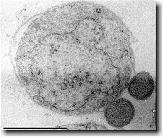

Nanoarchaeota
http://en.wikipedia.org/wiki/File:Urzwerg.jpg
N. equitans attached to the outer membrane of Ignicoccus. Scale bar = 1.0um. Courtesy of Huber et al. (2002)
Ignicoccus is a marine archaean and is the larger cell.
http://microbewiki.kenyon.edu/index.php/Nanoarchaeum

Slide 14
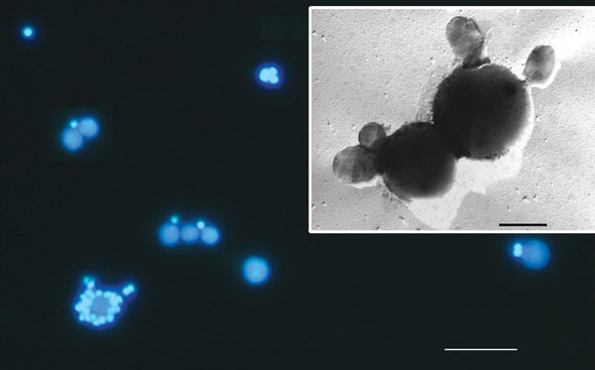
http://www.nature.com/nature/journal/v417/n6884/fig_tab/417027a_F1.html

Slide 15
Thaumarchaeota
Newest phyla “thaum” = wonder
“mesophilic” grow at moderate temperatures 15 and 40 °C (77 and 104 °F)
Important role in biogeochemical cycles (nitrogen cycle)
Marine archaea
Has an enzyme found in eukaryotes (DNA topoisomerase IB… used in DNA replication) gene has now been found in bacteria and partial sequences in viruses…
http://www.biology-direct.com/content/3/1/54

Slide 16
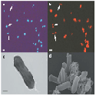
Nitrosopumilus maritimus
Autotrophic, marine,
Oxidizes ammonia (nitrogen cycle)

Slide 17
Links cited
http://www.cook.rutgers.edu/~dbm/lec14grad.pdf
http://en.wikipedia.org/ (various)
http://www.biology-direct.com/content/3/1/54
http://www.nature.com/nature/journal/v417/n6884/fig_tab/417027a_F1.html

